Slide 1
Kick off ALA AMO1
Hotel California
Period 4 AMO

Slide 2
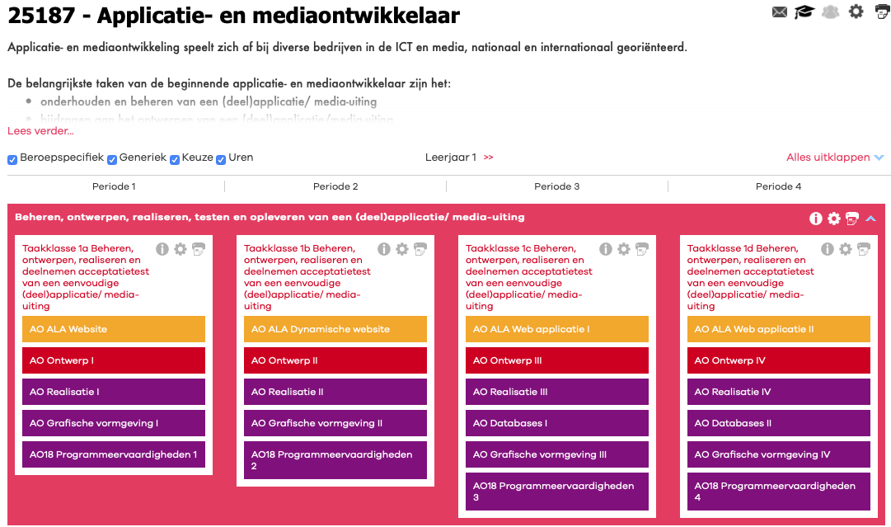
Course Outline

Slide 3
ALA Files
Download the ALA from the Course Catalog and/or your ALA teacher will sent it to you by e-mail.

Slide 4
STUDY GOALS ALA 4
Core tasks and work processes
1-K1 Contributes to the development process
B1-K1-W1 Sets the order
B1-K1-W2 Provides a contribution to the project plan
B1-K1-W3 Contributes to the design
B1-K1-W4 Prepares the realization
B1-K2 Realizes and tests (parts of) a product
B1-K2-W1 Realizes (parts of) a product
B1-K2-W2 Test the developed product
B1-K3 Returns a product
B1-K3-W1 Optimizes the product
B1-K3-W2 Returns the product
B1-K3-W3 Evaluates the delivered product

Slide 5
Courses beside this ALA during this period
Ontwerp IV
Realisatie IV
Database II
Grafische Vormgeving IV
Programmeervaardigheden IV
Generiek: Engels Nederlands Rekenen L&B

Slide 6
Assessors
Peter Hollenberg (PEHOL) will be the first assessor during this course with assistance from Dave Verhage (DAVER) as the second assessor.

Slide 7
where can you apply what you have learned
You're able to create digital order/reservation system as a self employed developer
You could work as a developer for a large hotel empire, bungalow discounter or holiday booker
You could work at or create a global booking site like booking.com or hotels.com

Slide 8
How many time do you need for this ALA?
Always start with a planning document
The maximum period for this ALA is 10 weeks
Remember all documents and presentations within this ALA need to be in the English language!

Slide 9

What have you learned?
Reflection
At the end of this ALA you create a reflection report. In this report you give insights on what you've accomplished, learned and what obstacles you have overcome.
Welcome to the Hotel California

Slide 10
The End
Thanks for watching and good luck!

